Slide 1
Alliance Financing Transition Track
All members call – 17.02.2021
UN-Convened Net-Zero Asset Owner Alliance

Slide 2
Agenda
Information Sharing - Housekeeping
Update of Sub tracks
Vehicles/Instruments
Blended Finance Call to Action to Asset Managers
Other sub track discussion (eg. on carbon removal instruments)
Target Setting/Reporting
(Principle based) Climate Solution Investment Reporting
Mapping Asset Classes to principles
Sectors/Asset Classes
Digital Round Map – for climate solution investments
Sector / Asset Class Roundtables

Slide 3
information sharing - Housekeeping
New file sharing tool: https://www.unepfi.org/alliance-extranet / password: netzerodoc
Strictly confidential – only for Alliance members
Only download possible, no uploading
To accommodate different time zones – proposal: alternate the monthly calls between
Wednesdays 5pm CET and
Wednesday 9am CET -> starting April in the morning
See presentation from Forestland Group and their feedback to our questions attached to the invite
We are planning to invite Respira (https://www.respira-international.com/) to the next All FinTrack Members call 17th of March to present carbon removal instruments, it will be set-up as an educational session.
Please find information about the European Hydrogen Backbone – “How a dedicated hydrogen infrastructure can be created” in the documents on the extranet.
The Engagement Track Kicked-off the Net Zero Position Paper Efforts – is there anyone from this track to join this group to also ensure alignment across the tracks work programs?

Slide 4
Agenda
Information Sharing - Housekeeping
Update of Sub tracks
Vehicles/Instruments
Blended Finance Call to Action to Asset Managers
Other sub track discussion (eg. on carbon removal instruments)
Target Setting/Reporting
(Principle based) Climate Solution Investment Reporting
Mapping Asset Classes to principles
Sectors/Asset Classes
Digital Round Map – for climate solution investments
Sector / Asset Class Roundtables

Slide 5
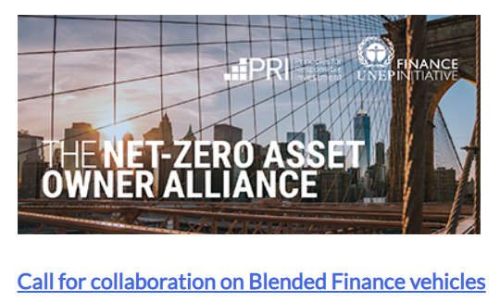
Blended Finance Vehicle – Call To Action To Asset Managers
Published 15th of February midnight see link on Alliance website
https://www.unepfi.org/news/net-zero-asset-owner-alliance-calls-on-asset-managers-to-support-blended-finance/
See application document on UNEPFI Extranet and here: https://www.unepfi.org/wordpress/wp-content/uploads/2021/02/Blended-Finance-Call-to-Action.pdf

Slide 6
Blended Finance Vehicle – Call To Action To Asset Managers
Media Coverage so far:
https://www.responsible-investor.com/articles/asset-owners-ask-investment-managers-to-pitch-ideas-for-green-blended-finance-vehicles (Top of RI’s daily newsletter) = for non-subscribers please see PDF attached in invite).
https://www.ipe.com/news/net-zero-asset-owner-group-seeks-asset-manager-blended-finance-action/10050716.article
https://www.investmentweek.co.uk/news/4027233/net-zero-asset-owner-alliance-calls-blended-finance-vehicles-invest-climate-solutions
https://www.businessgreen.com/news/4027228/net-zero-asset-owner-alliance-blended-finance-drive-climate-investment
https://www.climateaction.org/news/net-zero-asset-owner-alliance-calls-on-asset-managers-to-support-blended-fi?utm_source=ActiveCampaign&utm_medium=email&utm_content=Net-Zero+Asset+Owner+Alliance+calls+on+asset+managers+to+support+blended+finance+-+Climate+Action+News&utm_campaign=CA+%7C+2021+%7C+16+February+%7C+Newsletter&vgo_ee=yD8uLE31j8F7ZhdIdLHOjA%3D%3D
Big thank you and kudos to the “Blended Finance Call to Action Group” to Ash and to Oliver!

Slide 7
Blended Finance Vehicle – Call To Action To Asset Managers
Next steps
Please promote the call to action to asset managers, development banks and governments / ministries, please share proactively with your contacts
We already contacted the Net Zero Asset Manager Initiative
No deadline – ongoing call to action!
We (Ash and me) will collect replies, assess and publish on the Alliance website if the vehicles meet the criteria

Slide 8
Carbon Removal Instruments
First Assessment on Carbon removal instruments – see document in UNEPFI Extranet
Idea, assess pros/cons with respect to economics (risk/return) but also with respect to effective carbon removal
Instruments (draft assessment – work in progress)
Buy Certificates
Direct investment in commodity – nature based solutions
Direct investment negative emission technologies
Synthetic Index
Please share your views!
Additional instruments to be added?
Your assessment – please add and send to Elke!

Slide 9
Agenda
Information Sharing - Housekeeping
Update of Sub tracks
Vehicles/Instruments
Blended Finance Call to Action to Asset Managers
Other sub track discussion (eg. on carbon removal instruments)
Target Setting/Reporting
(Principle based) Climate Solution Investment Reporting
Mapping Asset Classes to principles
Sectors/Asset Classes
Digital Round Map – for climate solution investments
Sector / Asset Class Roundtables

Slide 10
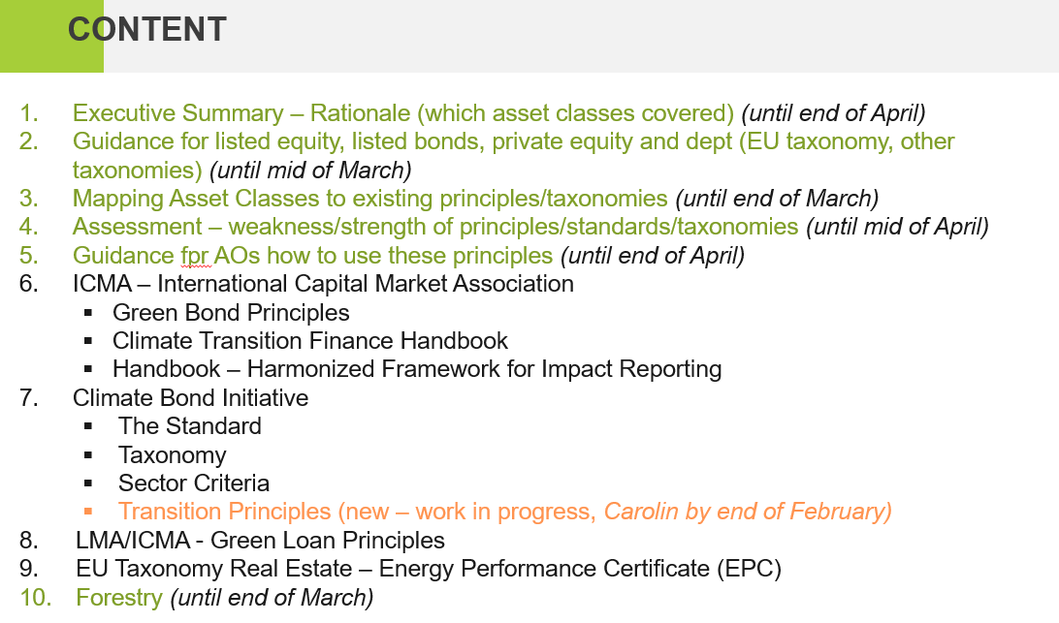
Principle Based Climate solution Investment Reporting
Status of Discussion:
The Sub Track is working on guiding principles – see current agenda proposal (draft document see UNEPFI Extranet), including planned deadlines:

Slide 11
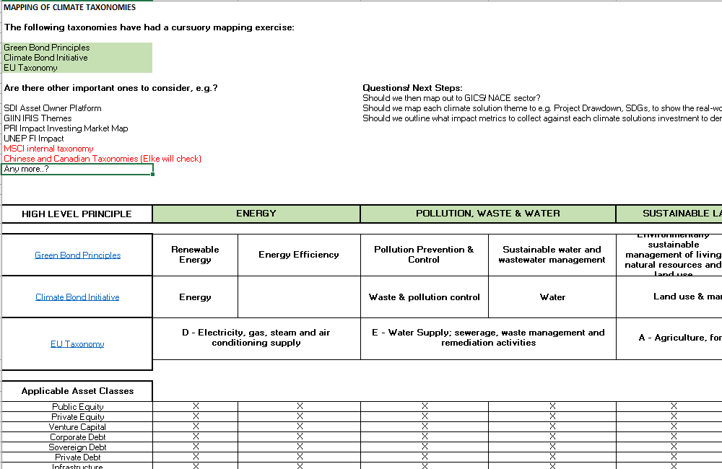
Principle Based Climate solution Investment Reporting
Next Steps
See timelines
Mapping Asset Classes to existing principles/taxonomies
Excel document in UNEPFI Extranet
Any other taxonomies/principles covering most asset classes/activities to be added? For now
Green Bond Principles
Climate Bond Initiative
EU Taxonomy

Slide 12
Agenda
Information Sharing - Housekeeping
Update of Sub tracks
Vehicles/Instruments
Blended Finance Call to Action to Asset Managers
Other sub track discussion (eg. on carbon removal instruments)
Target Setting/Reporting
(Principle based) Climate Solution Investment Reporting
Mapping Asset Classes to principles
Sectors/Asset Classes
Digital Round Map – for climate solution investments
Sector / Asset Class Roundtables

Slide 13
Digital Roadmap – Tender and Next Steps
Please find the draft version of the tender in the UNEPFI Extranet
Please send your remarks to Sona or Elke by Thursday 25th of February
Next Steps:
Share with the Reps Group Thursday 18th (fyi)
Share with the Comms Team – as the tender will be uploaded on the Alliance website
Uploaded on website beginning of March (?)
We are proactively addressing to the following initiatives:
OS Climate
Capital4Climate
Toniic Tracer
Phenix Capital
Drawdown Project
Clarity AI
Systemiq (?)
IMP+ACT Alliance (Claudia)
WEF (?)
Aligned Climate Capital: https://www.alignedclimatecapital.com/index.html#story
Any other initiative to be added?

Slide 14
Roundtables
Idea of a Real Estate Roundtable
Please add concrete questions where a roundtable adds value to help answer those questions.
Questions with a short-term perspective as well as mid to long-term view are highly welcomed!
Real Estate Roundtable questions:
1) What is needed to come to a positive business case for RE?
Given the differences in certification systems across countries – how can we come up with a single definition for what qualifies for being a net-zero building?
Mapping of building certificates (LEED, BREEAM etc.) to net-zero – is it possible?
What is best practice?
Challenges with the EU Taxonomy’s updated thresholds on the Real Estate/Construction Sector – how can we translate the upcoming regulation into practice?
Carbon offsetting and how could it be used in the case of real estate, so it adheres to AOAs climate solutions definition?
What is our role as investors towards policy makers?
2) New technology and investors ambition
- What does a technical transition of buildings looks like?
- Green lease – how does it work in practice and how can we harmonize the approaches across regions/countries?
Next Steps

